Slide 1

Quick sort algorithm
Name : Mohamed Haitham
ID :213153

Slide 2
agenda
Introduction
Problem
Examples
Result
analysis

Slide 3
introduction
QuickSort is a divide and conquer algorithm. It picks an element as a pivot and partitions the given array around the picked pivot.
There are many different versions of quickSort that pick pivot in different ways.
Always pick the first element as a pivot
Always pick the last element as a pivot
Pick a random element as a pivot
Pick median as a pivot

Slide 4
problem
The problem is sorting any given array of numbers or other elements

Slide 5
Example 1
sort the following array of numbers [1, 4, 5, 8, 6, 7, 2, 3,9]

Slide 6
Example 2(text book)
Apply quicksort to sort the list E, X, A, M, P , L, E in alphabetical order.

Slide 7
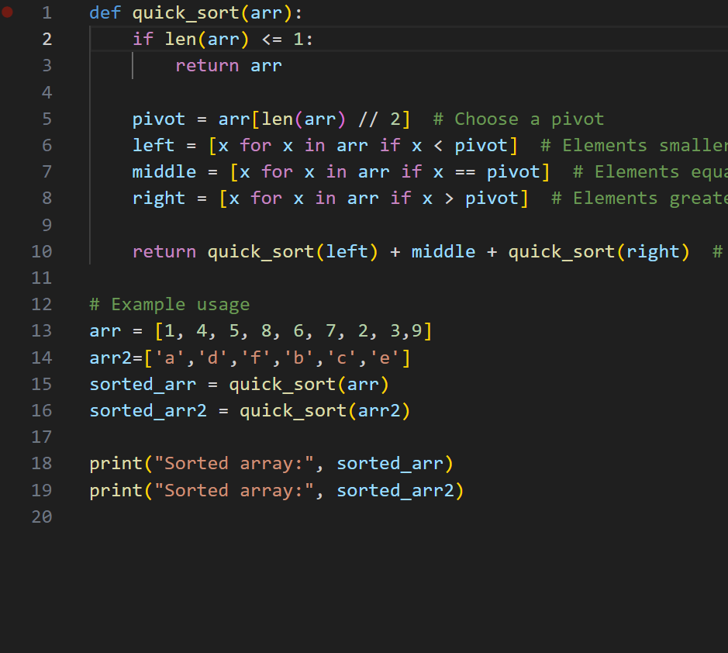
The used code

Slide 8
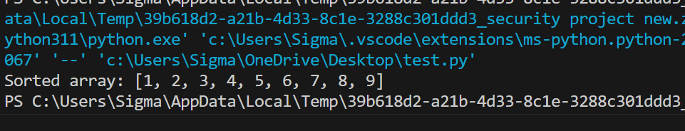
Result 1

Slide 9
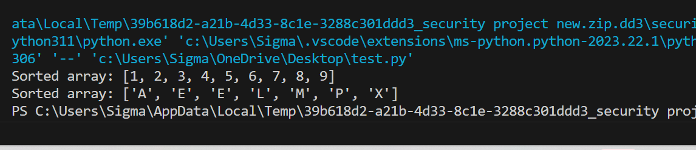
Result 2

Slide 10
Analysis worst case
Worst Case: O(n^2) - When the pivot selection consistently divides the array into substantially unequal parts.
T(n)=T(n−1)+O(n)
T(n)=T(n−1)+O(n)=T(n−2)+O(n−1)+O(n)=T(n−k)+O(n−k+1)+O(n−k+2)+….+O(n)
The base case T(1)=O(1)
T(n)=O(n)+O(n−1)+O(n−2)+...+O(1)
T(n)=O(1+2+3+…..+n) =O(n(n+1)/2 )=O(n2)

Slide 11
Analysis best case
Best Case: O(n log n) - When the pivot is chosen such that it divides the array into equal halves.
T(n)=2T(n/2 )+O(n)
T(n)=2T(n/2 )+O(n)=2⋅2T(n/4 )+O(n/2 )+O(n)==2^k *T(n/2^k )+kO(n)
T(n)=2^logn⋅O(1)+logn⋅O(n)=n⋅O(1)+O(nlogn)
Tn=O(n log n)

Slide 12
Thank you

